Slide 1


New Faculty Orientation
Dr. Mark Byrnes
Provost
August 18, 2025

Slide 2


Welcome to MTSU!
Greeting new faculty is one of the best parts of a new academic year.
You are key to the work of the University.
Focus on our students
MTSU’s campus culture
Notes:
Greeting is best part; You are key to work; Focus on students; Great place to work

Slide 3
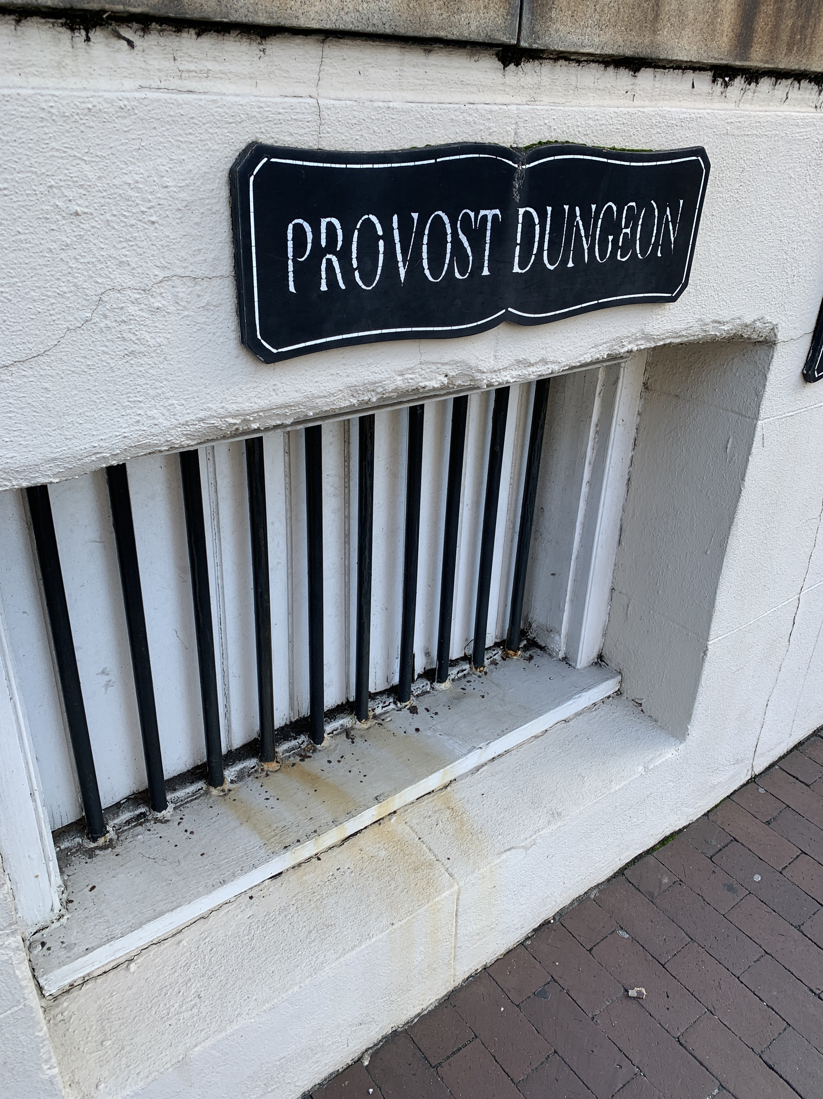
What is a Provost?
One definition:
The keeper of a prison.
Notes:
“prison keeper” (Charleston) and “all-powerful ruler” definitions
Transition to the real definition: Academic mission; Collaborator; Rooted in service

Slide 4

What is a Provost?
Another definition:
All-powerful ruler.
This Photo by Unknown Author is licensed under CC BY-NC-ND
Notes:
“prison keeper” (Charleston) and “all-powerful ruler” definitions
Transition to the real definition: Academic mission; Collaborator; Rooted in service

Slide 5
What is a Provost?
Leader of the University’s academic mission
Collaborator with deans, chairs, faculty, and staff to provide high-quality academic programs and instruction
A job of service

Slide 6
Who Am I?
Riverdale High School, MTSU, London School of Economics, Vanderbilt University
Professor, Internship Coordinator, Chair, Associate Dean, Dean, Provost
Notes:
Brief overview of education and professional journey; Family and hobbies.

Slide 7

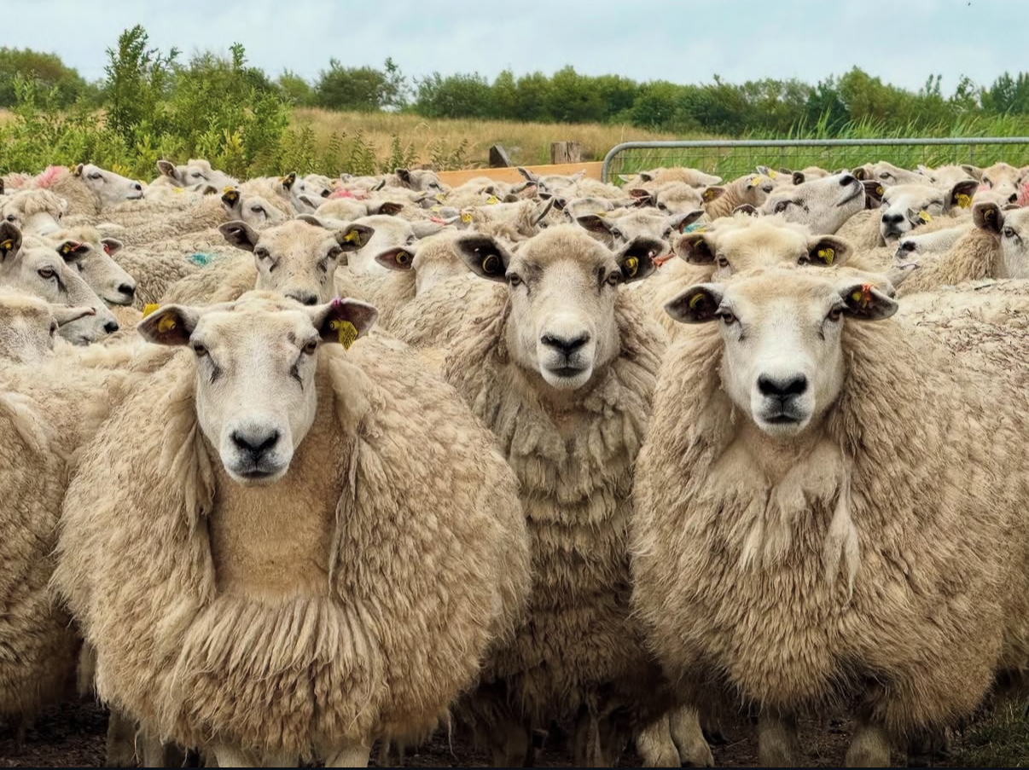
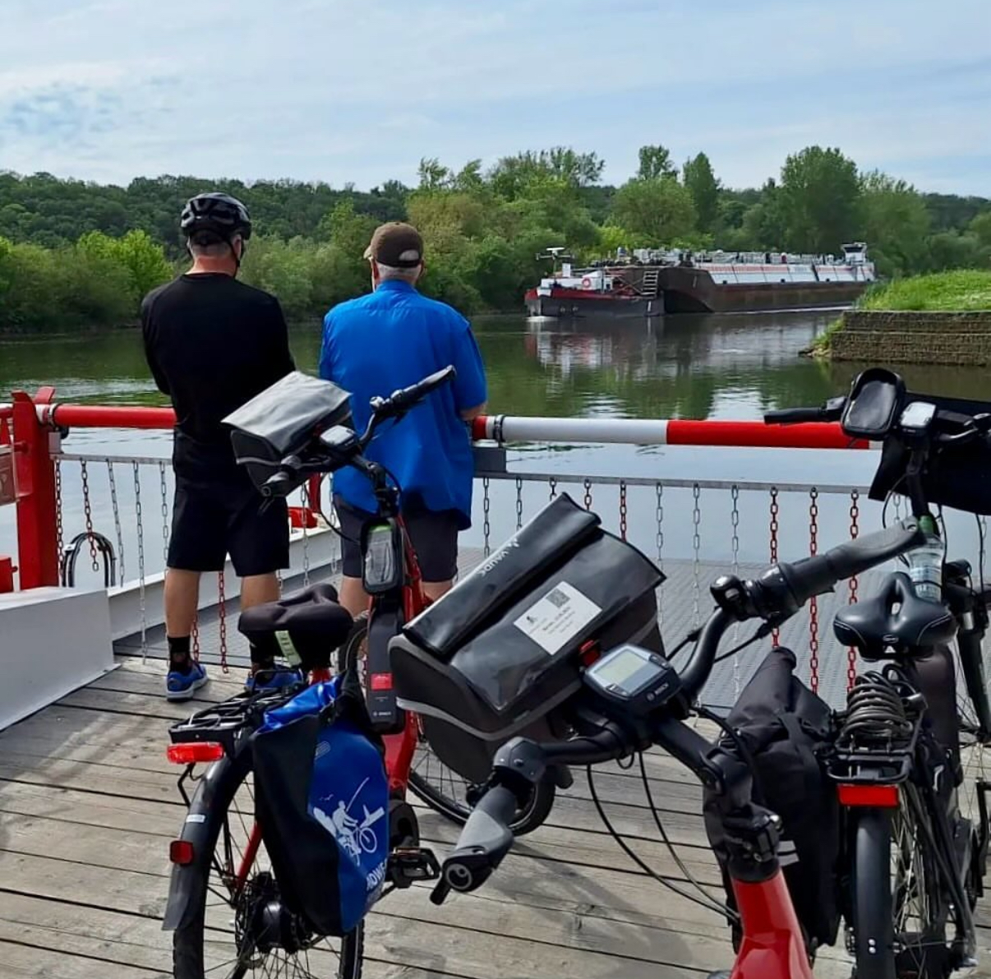
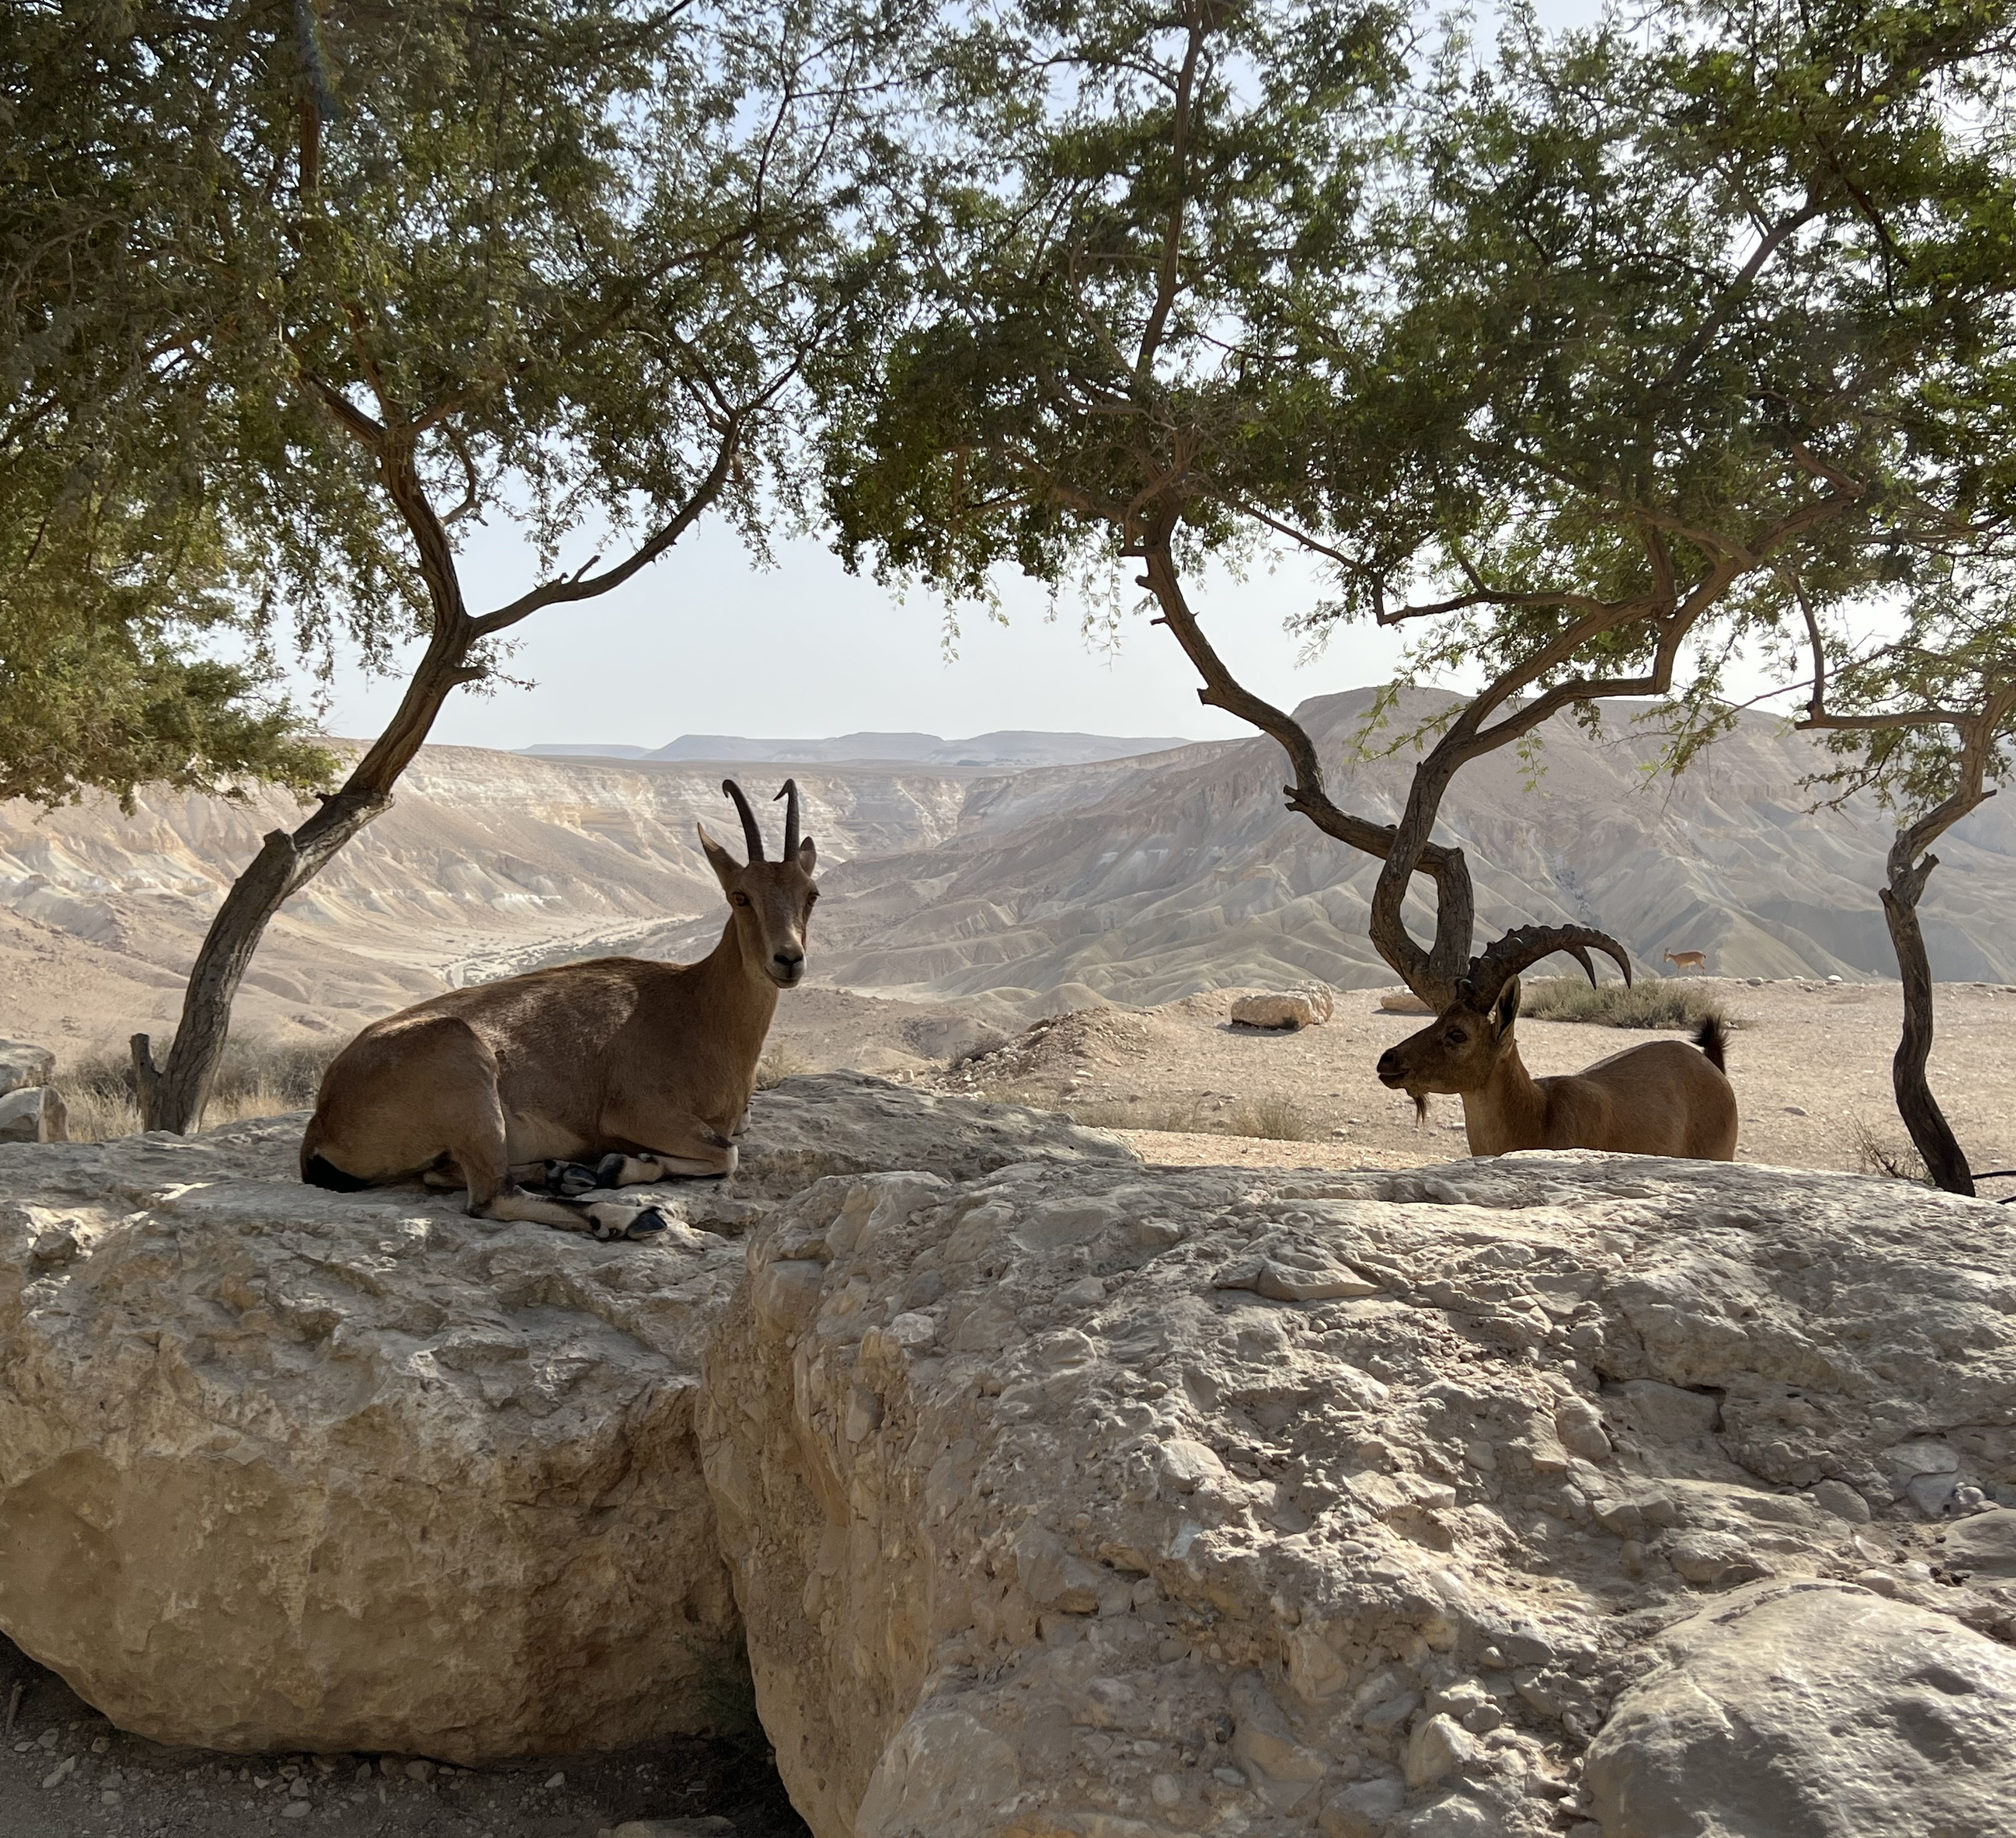
Who Am I?
Three children, two grandchildren
Travel, cycling, photography, Lego, gardening
Notes:
Brief overview of education and professional journey; Family and hobbies.

Slide 8
Priority Initiatives for AY 25-26
Enrollment management and student success
Faculty and staff professional development
Canvas implementation – mtsu.edu/canvas
Notes:
Enrollment and student success. Professional development.
Canvas implementation (mention mtsu.edu/canvas). SACSCOC reaffirmation.
AI integration. Strategic Plan 2035.

Slide 9
Priority Initiatives for AY 25-26
SACSCOC reaffirmation
Artificial Intelligence (AI)
Strategic Plan 2035
Notes:
Enrollment and student success. Professional development.
Canvas implementation (mention mtsu.edu/canvas). SACSCOC reaffirmation.
AI integration. Strategic Plan 2035.

Slide 10
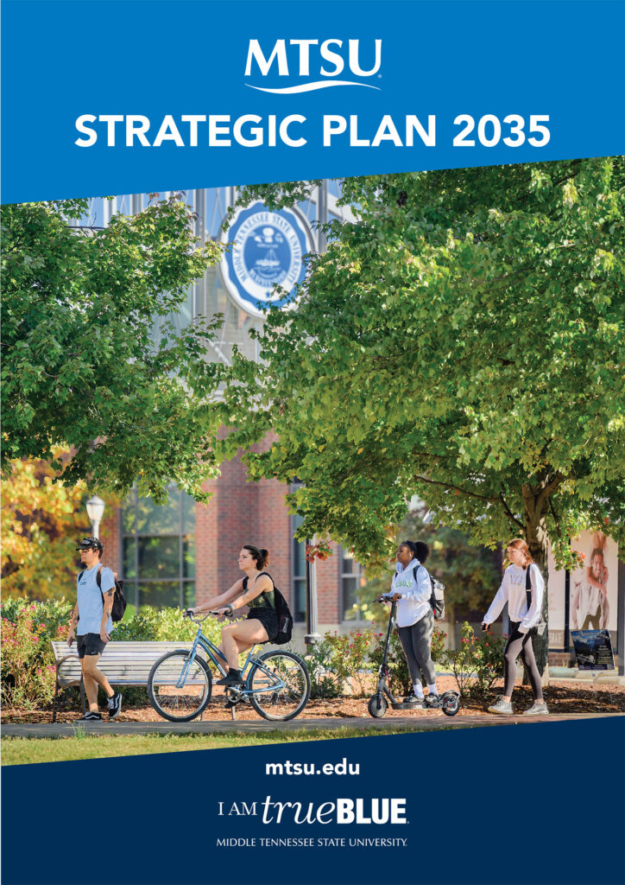
Strategic Plan 2035
A single, unifying vision
Collaborative process
Implementation updates at:
mtsu.edu/strategicplan
Notes:
Explain the vision and collaborative nature of the plan. Mention mtsu.edu/strategicplan for updates. Goals overview

Slide 11
Strategic Plan 2035
Increase the institution’s creative and research profile and be a top choice for students.
Strengthen the community so all learners and workers thrive.
Cultivate sustainable partnerships.

Slide 12
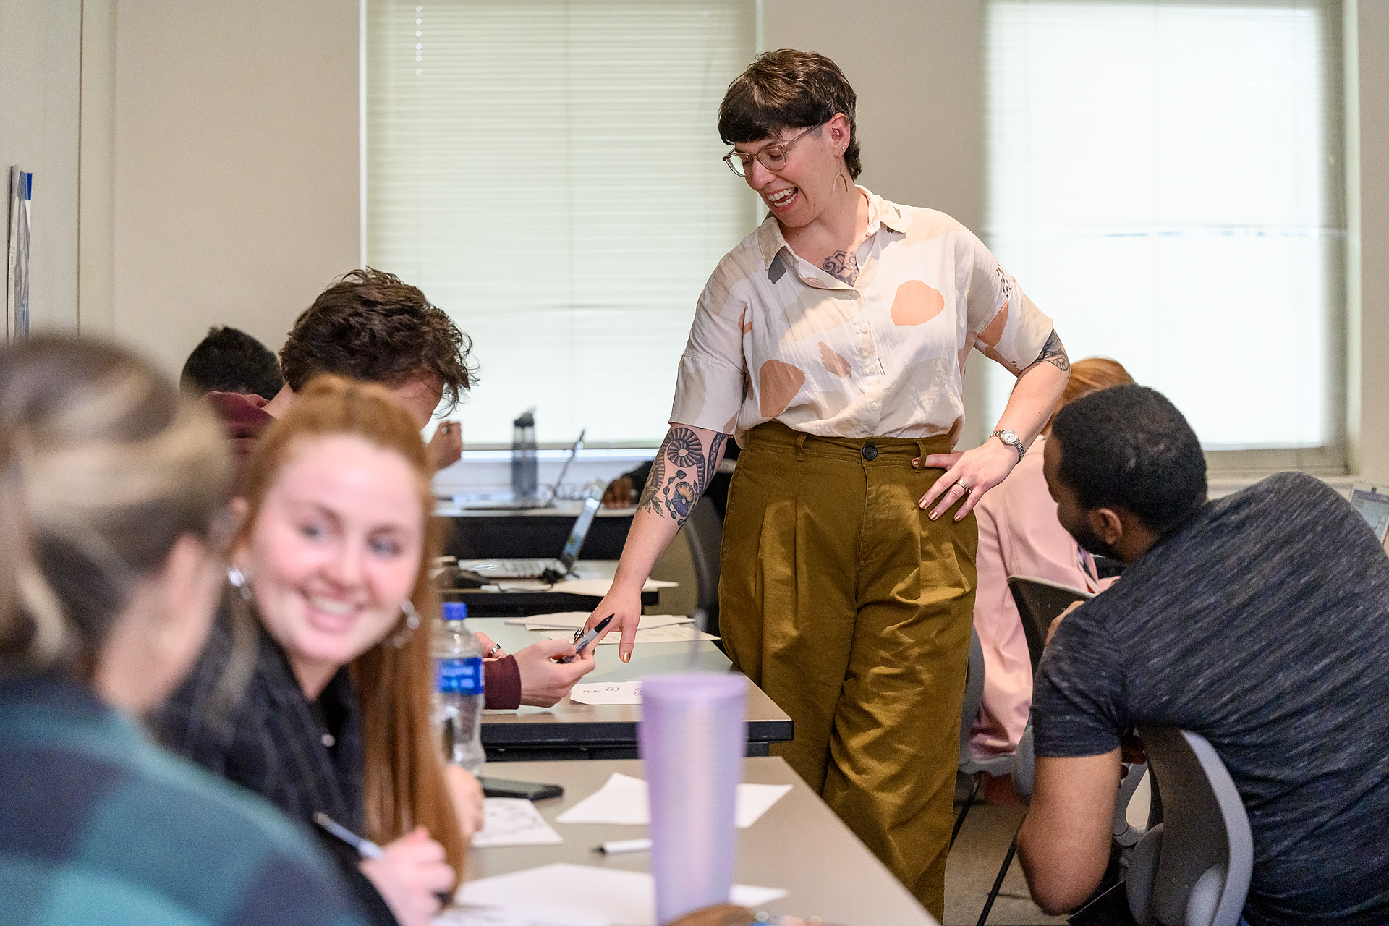
Faculty Roles and Responsibilities
Teaching
Research/Creative Activity
Service
Primary goals: student success and professional growth
Notes:
Teaching, Research/Creative Activity, Service. Emphasize student success and faculty growth as core goals.

Slide 13
Tips from Fellow Faculty
Review the Faculty Handbook: faculty.mtsu.edu/fac_handbook/.
Start tracking your accomplishments immediately.
Check email for updates/deadline reminders.
Get to know Faculty Success and D2L/Canvas.
Notes:
Review Faculty Handbook. Track accomplishments early.
Stay on top of email and systems (D2L/Canvas) [don’t miss email about Provost’s Cycling Convoy for Homecoming]
Engage in professional development. Build relationships with students and peers. Fried Chicken Wednesdays

Slide 14
Tips from Fellow Faculty
Devote time to professional development; attend workshops.
Get to know your students.
Build your networks.
Try Fried Chicken Wednesdays at McCallie.
Notes:
Review Faculty Handbook. Track accomplishments early.
Stay on top of email and systems (D2L/Canvas) [don’t miss email about Provost’s Cycling Convoy for Homecoming]
Engage in professional development. Build relationships with students and peers. Fried Chicken Wednesdays

Slide 15
Center for Teaching and Mentoring
Mentorship, professional development, support
Canvas implementation, training hub
Writing retreats, large class playbook, learning communities, faculty fellows, new faculty series
Comprehensive programming for faculty, student-facing staff, and graduate students
Notes:
Mentorship, training, retreats. Canvas support. Programming for faculty and graduate students. Shout out to JVH.

Slide 16

Fall Faculty Meeting
August 21, Tucker Theatre, 10 AM
State of the University
Welcome and New Faculty Introduction
Faculty Awards and Recognition
Free lunch!
Notes:
August 21, Tucker Theatre, 10 AM. State of the University, awards, introductions.
Free lunch!

Slide 17
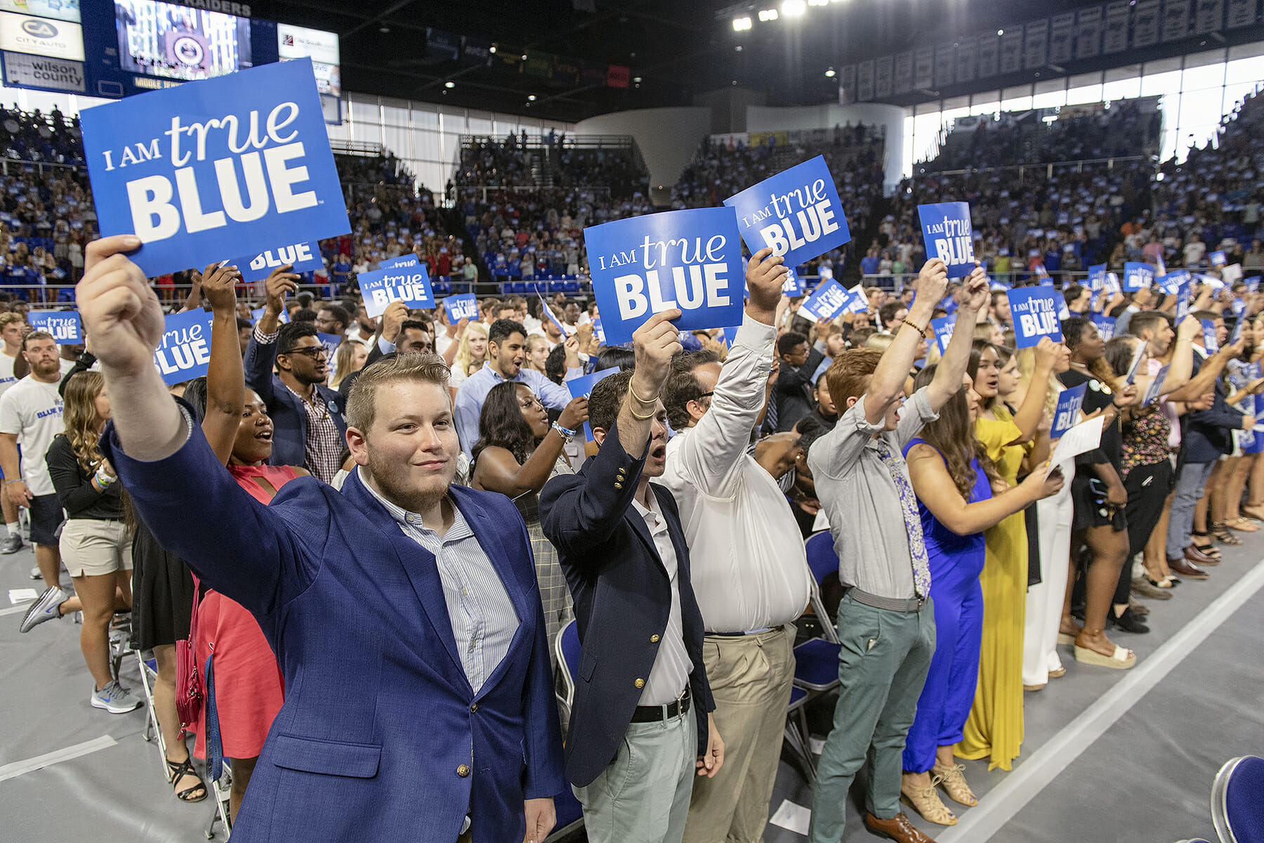

Convocation
August 23, Murphy Center, 4 PM
Keynote Speaker: Bob Welch
Notes:
August 23, Murphy Center, 4 PM.
Keynote by Bob Welch— Healing Wounds: A Vietnam War Combat Nurse’s 10-year fight to Win Women a Place of Honor in Washington, D.

Slide 18
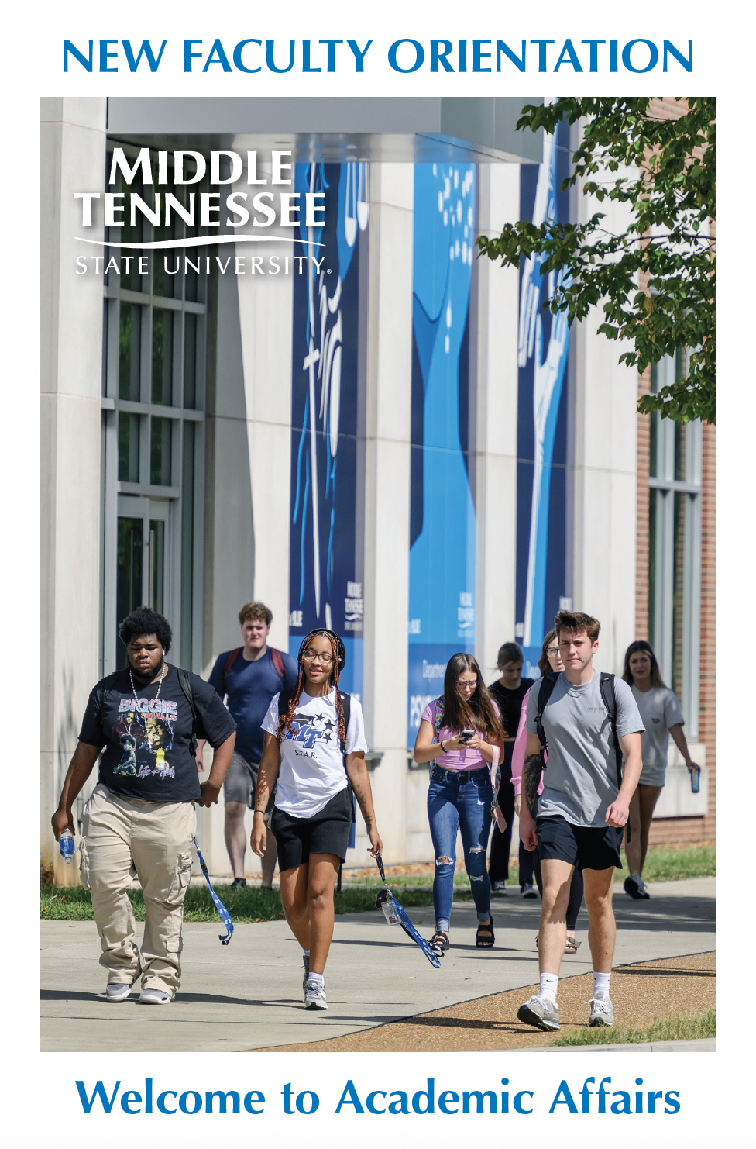
Academic Affairs Team
Our main offices are in the Cope Administrative Building (CAB) Rooms 110 and 111, and our regular office hours are 8:00 AM- 4:30 PM.
provost.mtsu.edu; (615) 898-2880
Notes:
Bios and titles in NFO booklet; most of team in Cope. We are accessible.

Slide 19
Conclusion
Need help? Ask.
Get involved in campus life.
Get to know your students and colleagues.
You can contact our team anytime.
We are glad you are here!
Notes:
Reiterate support: “Need help? Ask.” Encourage campus involvement and relationship-building. Thank and congratulate again.

Slide 20
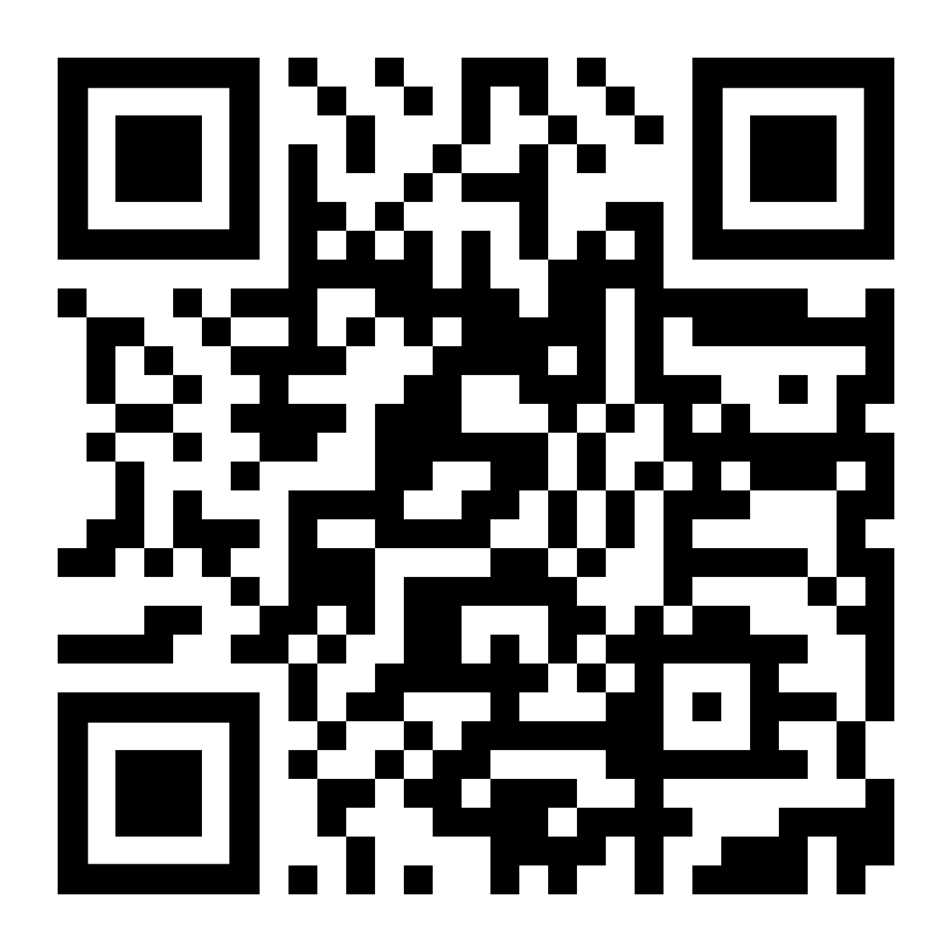
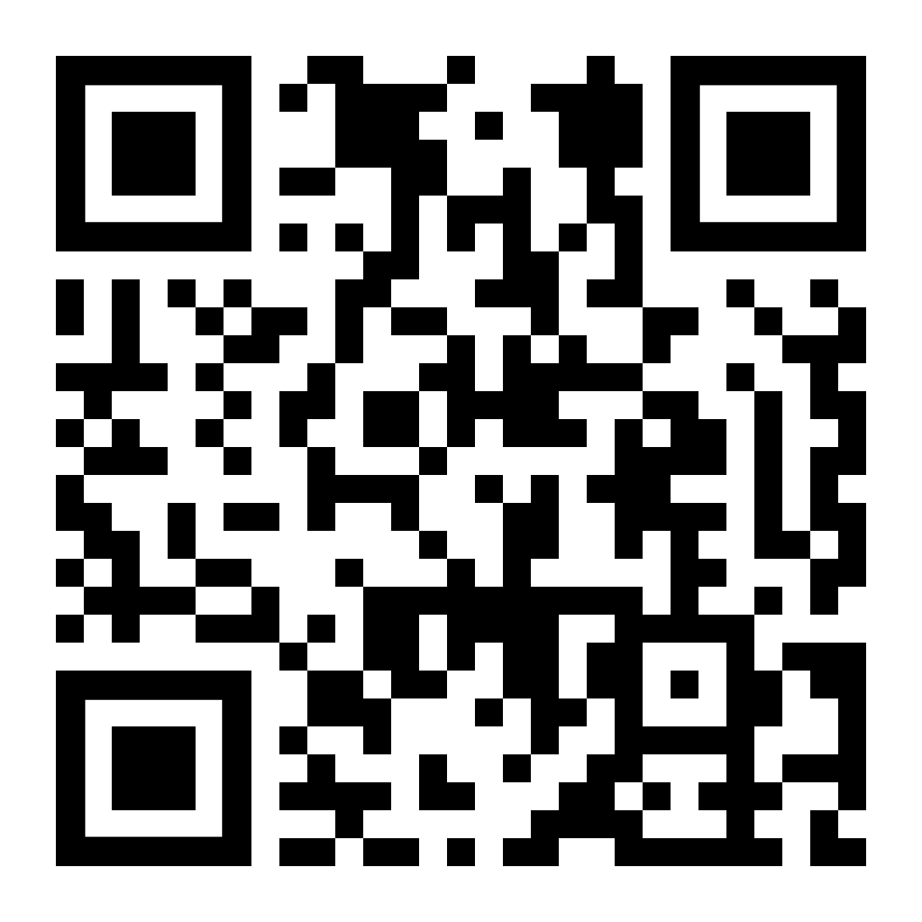
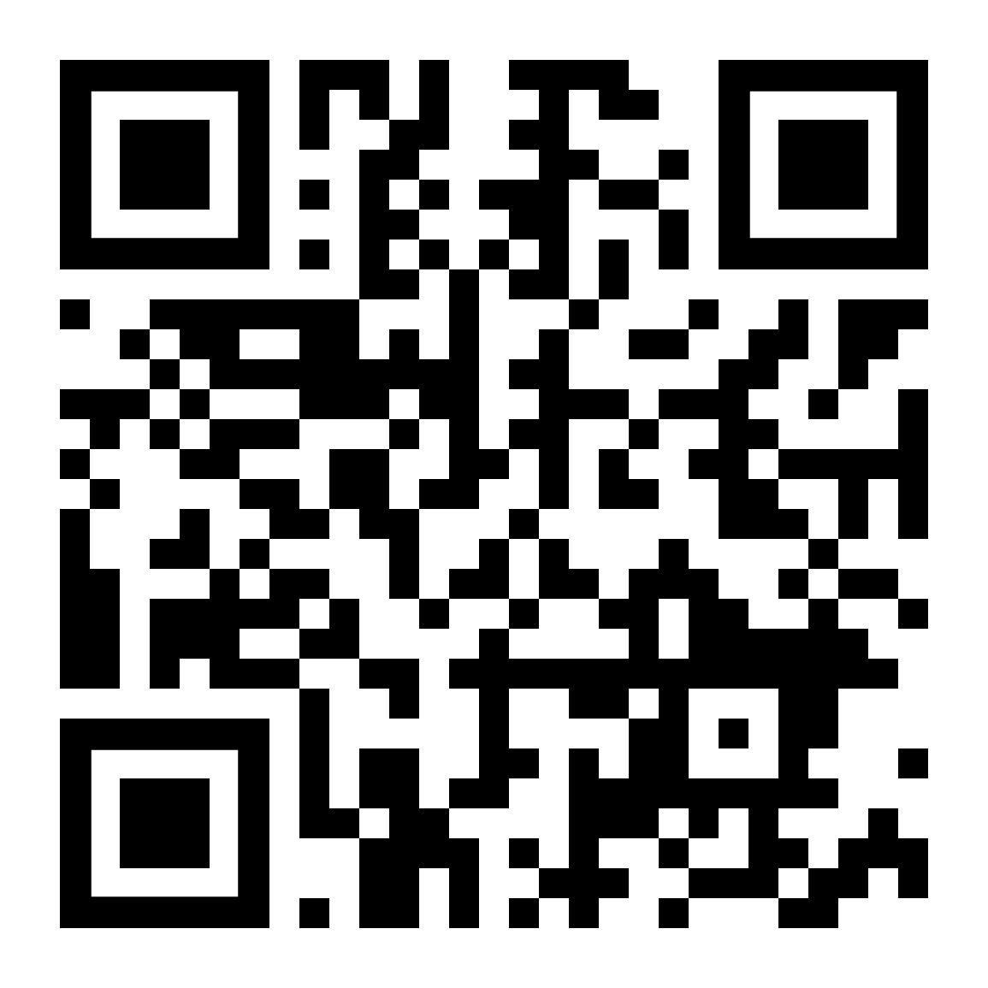
Featured Links
Faculty Handbook
Strategic Plan
Canvas
Notes:
Reiterate support: “Need help? Ask.” Encourage campus involvement and relationship-building. Thank and congratulate again.

